Slide 1

Continuous Probability Distributions
Chapter 7

Slide 2
Objectives
Read textbook sections 7.1 – 7.4.
Know the properties of a continuous random variable and probabilities related to them.
Understand how to calculate probabilities and cut-off values from
  the Uniform Distribution,
  the Standard Normal Distribution, and
  other Normal Distributions.
Understand the relationship between z-scores and data values.
Apply the Central Limit Theorem to the sampling distributions of Sample Means and Sample Proportions.

Slide 3
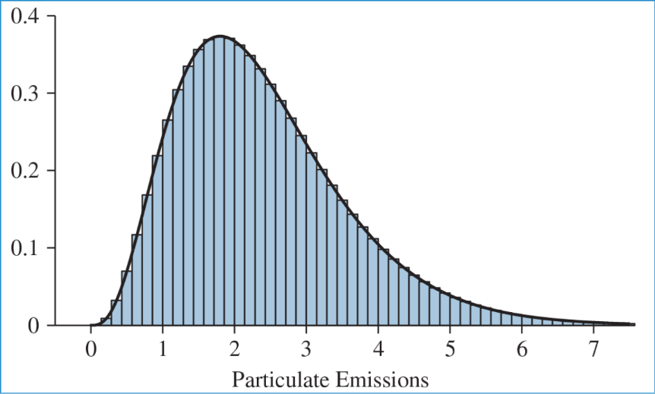
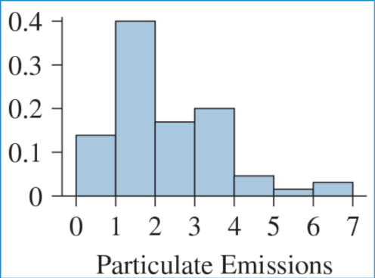
From a Histogram to a Probability Density Curve
Relative Frequency Histogram of
Particulate Emissions (N=millions)
Relative Frequency Histogram of
Particulate Emissions (n=65)
The more rectangles we have in the histogram, the closer the distribution resembles a curve. This is the probability density curve of a continuous random variable. The width of each rectangle approaches zero and thus, becomes a line.

Slide 4
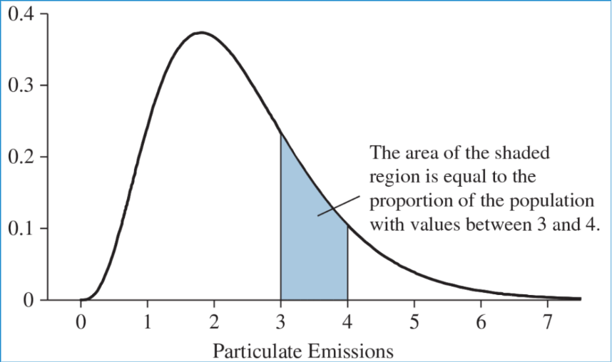
The Area Underneath the Curve
(Integration Review)
The area under the curve between two values, a and b, has two meanings:
The proportion of the population whose values are between a and b.
The probability that an individual from the population will have a value between a and b.

Slide 5
Continuous Random Variables
For continuous random variables:
P(X = a) = 0
P(a < X < b) = P(a ≤ X ≤ b)
X can never equal one exact numerical value.
number line
The total area underneath the entire curve of a distribution equals 1.

Slide 6
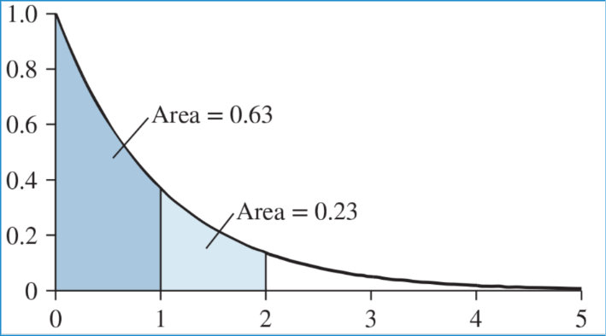
Area = Probability = Proportion
What is the area of the unshaded (white) region?
What proportion of values are between 0 and 2?
What is the probability that an individual from the population will be between 1 and 2?
What proportion of values are greater than 1?
True or false? P(X>1) = P(X≥1)

Slide 7
The Uniform Distribution
A uniform distribution is just one type of continuous distribution.
All values are equally likely, so the “curve” of the distribution is a straight horizontal line, which gives us a probability rectangle. How do you find the area of a rectangle?
These distributions are often used to model waiting times (for example, waiting time until you are seen for an appointment).

Slide 8
Uniform Distribution Examples
Waiting Time: A subway train arrives every 10 minutes, and the arrival time is equally likely at any moment within those 10 minutes (0–10 mins).
Random Number Generation: A computer program picks a random number between 0 and 100, where 35.5 is as likely as 72.1.
Distance/Location: The location where a specific defect occurs on a 100-meter textile roll, assuming it can happen anywhere with equal probability.
Shuttle Stop Time: A shuttle takes exactly 20 minutes to travel between stop A and B, making the arrival time at stop A unpredictable, but uniform.

Slide 9
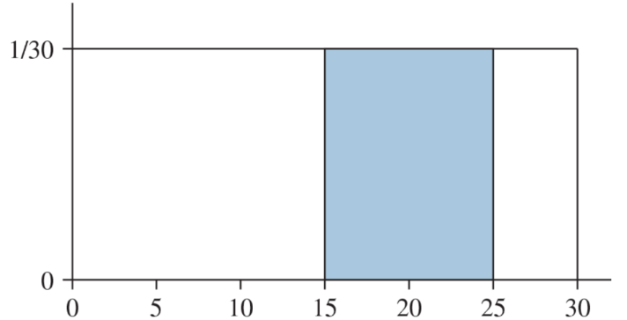
Waiting for an Appointment
The probability that you will wait between 15 and 25 minutes.
Area = length * height = (25 – 15) * (1/30) = 10/30 = 0.3333
Practice:
1. What proportion of people wait more than 20 minutes?
2. What is the probability that a person will wait between 5 and 10 minutes?
3. What proportion of people will wait between 7 minutes and 19 minutes?
Probability
Minutes

Slide 10
Uniform Probabilities with R
P(X<x) = punif(x, min, max, lower.tail = TRUE)
*draw example image

Slide 11
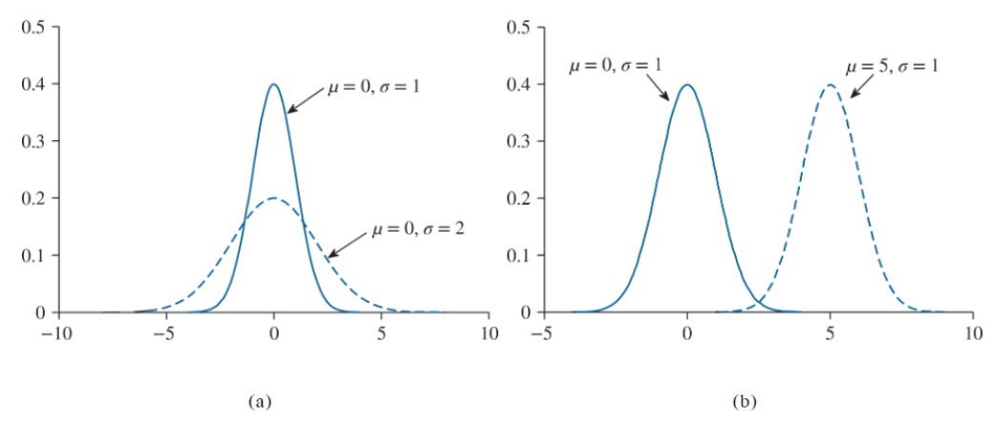
The Normal Distribution
A population follows a normal distribution if it’s unimodal and symmetric about the mode (the peak).
Mean = Median = Mode for all Normal distributions.
Explore this interactive graph: Interactive Normal Distributions

Slide 12
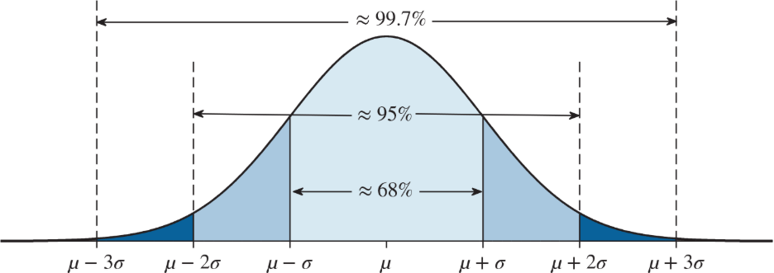
Normal Distributions Follow the Empirical Rule
We have used the Empirical Rule to approximate percentages, but there are methods to calculate them more precisely.

Slide 13
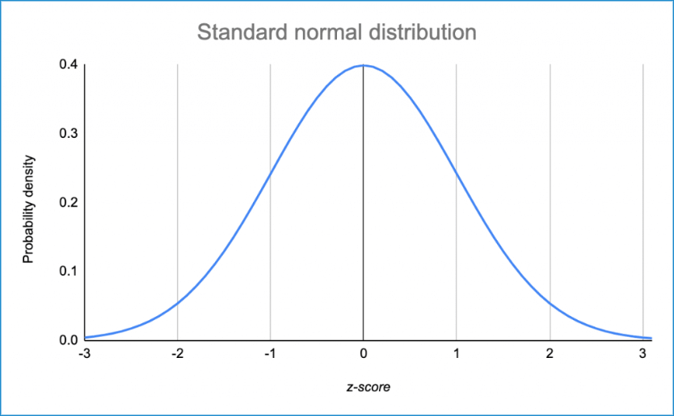
The Standard Normal Distribution
The Standard Normal Curve is one particular type of Normal Distribution. Specifically, it is the distribution of standardized values, or z-scores. It has a mean of 0 and a standard deviation of 1.
Z ~ Normal(0, 1)
Using R Studio to calculate areas:
pnorm(z-value, mean, standard deviation)
Calculating z-scores that cut off certain areas.
qnorm(area, mean, standard deviation)

Slide 14
Calculating Probabilities of Z-Scores
What proportion of z-scores are less than 1?
What is the probability of a z-score being greater than -2?
What proportion of z-scores are less than 0.458?
What is the probability that z is between -1 and 1?
What proportion of z-scores are between 1.7 and 2.06?
What z-score has an area of 0.13 to the left?
What z-score has 5% of the data values to the right?
What z-score is greater than 80% of z-scores (aka at the 80th percentile)?
What two z-scores mark the middle 30% of z-scores?
What two z-scores mark the middle 45% of z-scores?

Slide 15
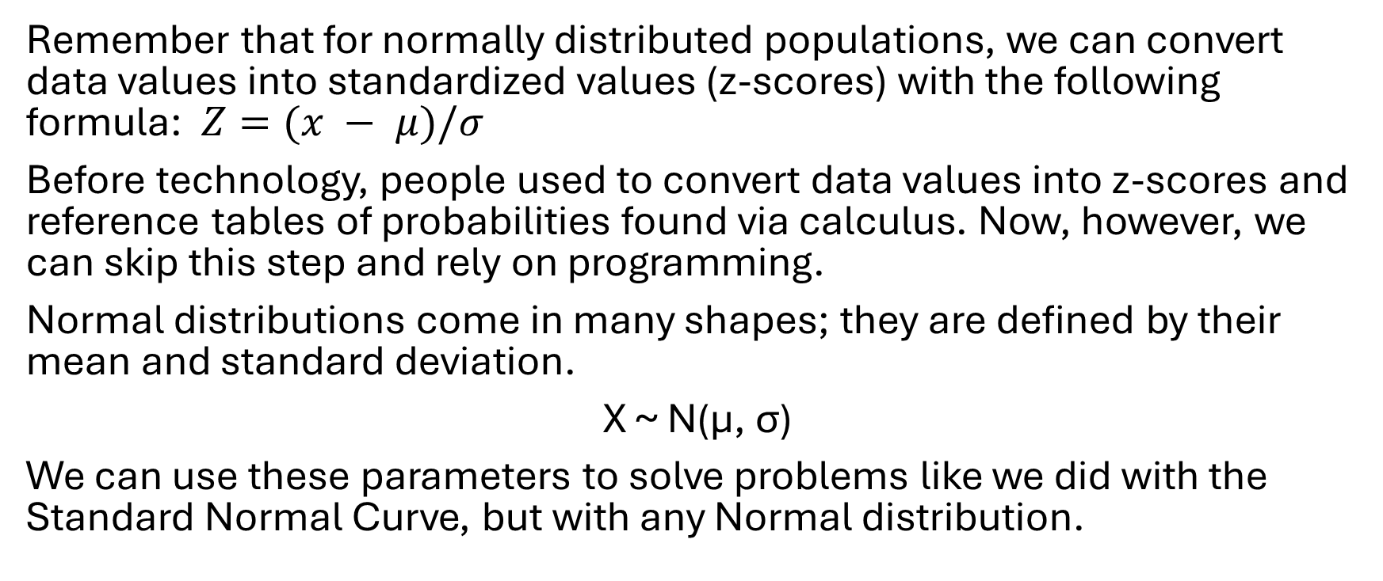
Applications of the Normal Distribution
Remember that for normally distributed populations, we can convert data values into standardized values (z-scores) with the following formula: $Z=(x − μ)/σ$
Before technology, people used to convert data values into z-scores and reference tables of probabilities found via calculus. Now, however, we can skip this step and rely on programming.
Normal distributions come in many shapes; they are defined by their mean and standard deviation.
X ~ N(µ, σ)
We can use these parameters to solve problems like we did with the Standard Normal Curve, but with any Normal distribution.

Slide 16
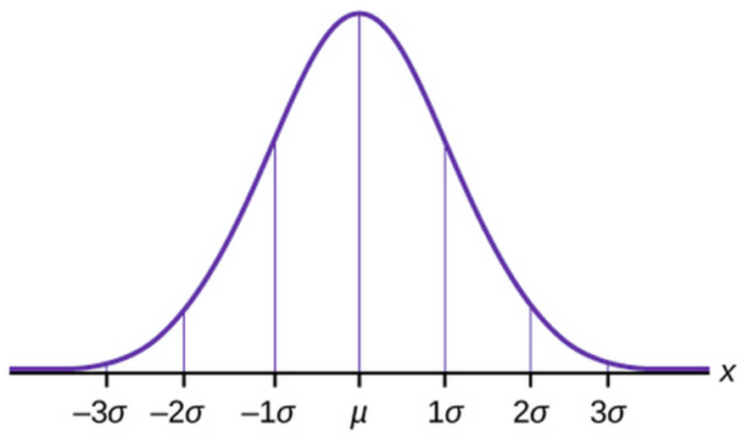
Baby Weights Example
According to an NHS report, the weight of male babies under two months old in the U.S. is normally distributed with a mean of 11.5 pounds and a standard deviation of 2.7 pounds.
X~N(11.5, 2.7)
3.4 6.1 8.8 11.5 14.2 16.9 19.6

Slide 17
Baby Weights Practice
What proportion of babies weigh more than 13 pounds?
What proportion of babies weigh less than 15 pounds?
What is the probability that a randomly selected baby boy will weigh between 10 and 14 pounds?
What is the probability of a baby boy weighing more than 17 pounds?
Would it be unusual for a baby boy to weigh less than 7 pounds?
What weight is at the 75th percentile of male baby weights?
What weight is at the 15th percentile?
What weight marks the top 5% of weights?
What weights mark the middle 20% of weights?

Slide 18
Electricity Bill Example
The mean monthly electric bill from recent data was $110.14 with a standard deviation of $22.50. The cost is normally distributed.
42.64 65.14 87.64 110.14 132.64 155.14 177.64

Slide 19
Electricity Bill Practice
What proportion of bills are greater than $130?
What proportion of bills are between $85 and $140?
What is the probability that a bill is less than $120?
What bill amount is at the 30th percentile?
What bill amount marks the upper 15% of bills?
Is a bill of more than $200 unusual?

Slide 20
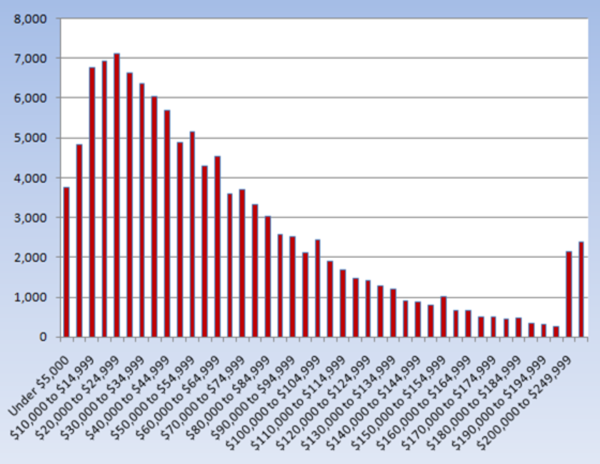
Sampling Distributions and the Central Limit Theorem
Let’s look at the population distribution of U.S. Household Income. How would you describe its shape?
Let’s say we take a simple random sample of 50 U.S. households and calculate the mean income of that sample. Now we have a sample mean.
Now let’s take another simple random sample of 50 U.S. households and calculate the mean income of that sample. We can repeat the process many times and have many sample means.
We can create a distribution of those sample means. It would be called a sampling distribution of sample means.

Slide 21
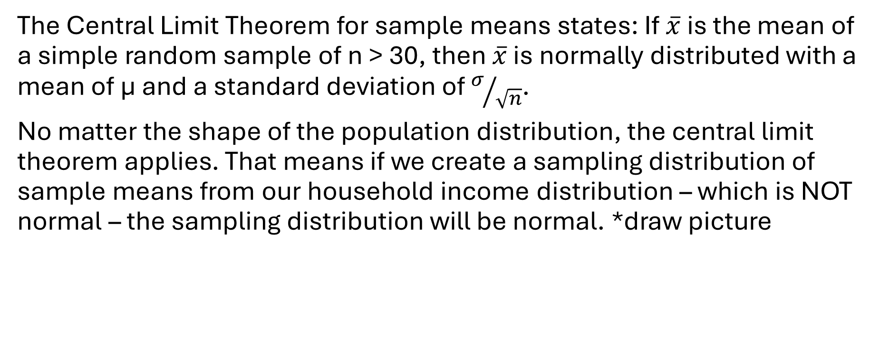
Sampling Distributions of Sample Means
The Central Limit Theorem for sample means states: If $\overline{x}$ is the mean of a simple random sample of n > 30, then $\overline{x}$ is normally distributed with a mean of µ and a standard deviation of $σ/{\sqrt{n}}$.
No matter the shape of the population distribution, the central limit theorem applies. That means if we create a sampling distribution of sample means from our household income distribution – which is NOT normal – the sampling distribution will be normal. *draw picture

Slide 22
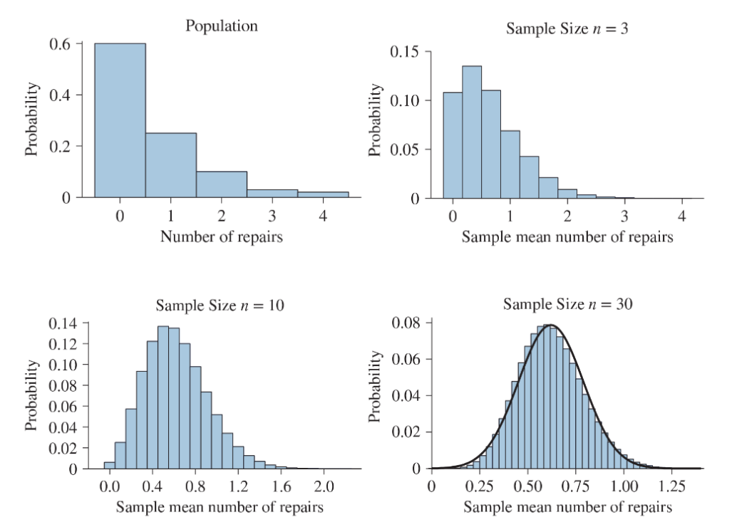
Minimum
Sample
Size
*unless we know that the population is normal

Slide 23
Calculating the Parameters
Example: A population has a mean of 55 and a standard deviation of 3. We will take simple random samples of size 45. What are the mean and standard deviation of the sampling distribution of sample means?

Slide 24
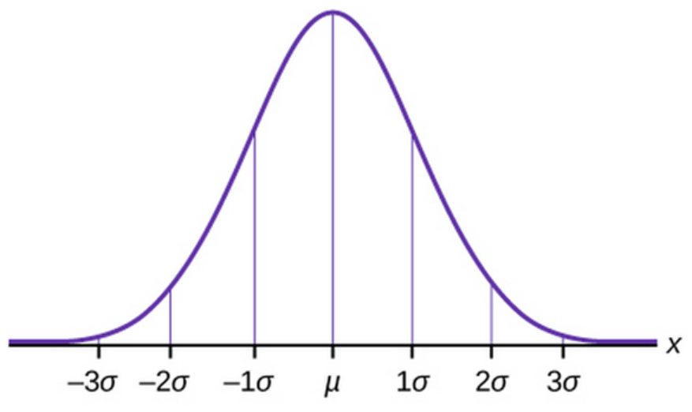
Calculating Probabilities – Mileage Example
Example: The EPA says that the mean highway gas mileage of the 2020 Hyundai Elantra is 28 mpg with a standard deviation of 3 mpg. A rental car company purchases 60 of these cars.
What are the mean and standard deviation of the sampling distribution of sample means?
What is the probability that the mean mileage of this group of cars is less than 27 mpg?
What proportion of sample means are greater than 28.5 mpg?
What is the probability that the sample mean is between 27 and 29.5 mpg?
What sample mean marks the 75th percentile?
What sample mean marks the top 5%?

Slide 25
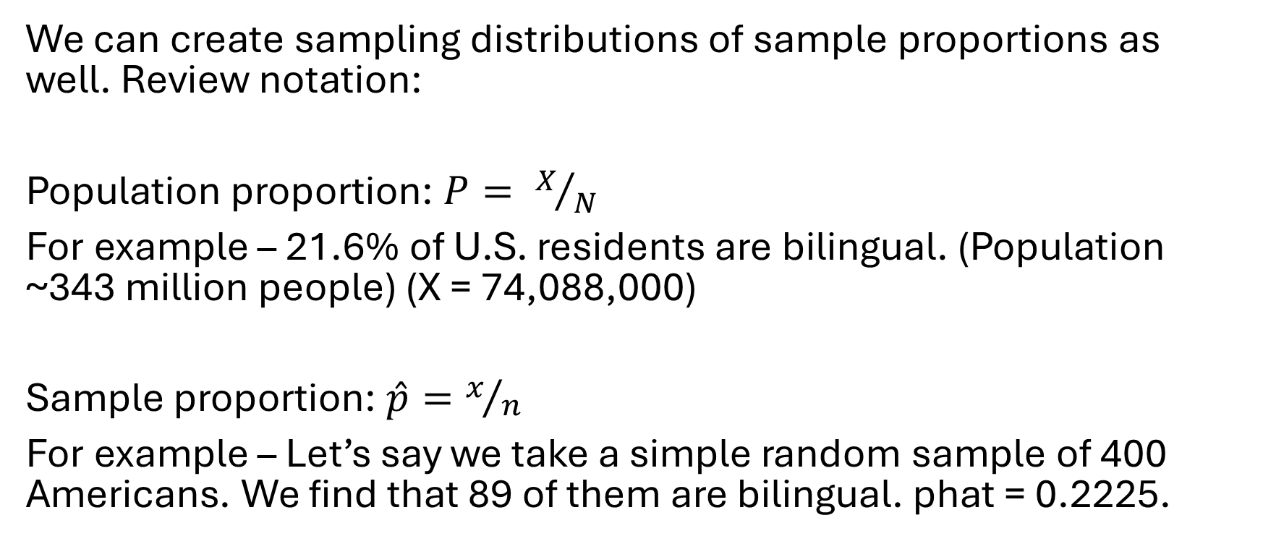
Proportions
We can create sampling distributions of sample proportions as well. Review notation:
Population proportion: $P= X/N$
For example – 21.6% of U.S. residents are bilingual. (Population ~343 million people) (X = 74,088,000)
Sample proportion: $\hat{p}=x/n$
For example – Let’s say we take a simple random sample of 400 Americans. We find that 89 of them are bilingual. phat = 0.2225.

Slide 26
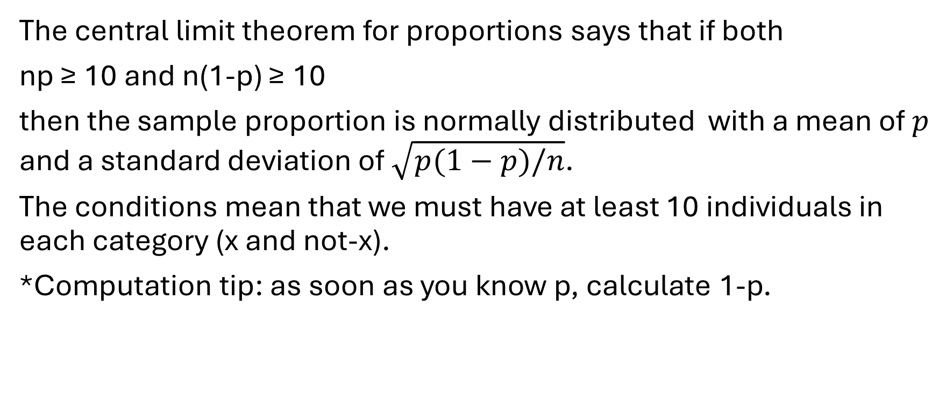
The Central Limit Theorem for Sample Proportions
The central limit theorem for proportions says that if both
np ≥ 10 and n(1-p) ≥ 10
then the sample proportion is normally distributed with a mean of $p$ and a standard deviation of $\sqrt{p(1−p)/n}$.
The conditions mean that we must have at least 10 individuals in each category (x and not-x).
*Computation tip: as soon as you know p, calculate 1-p.

Slide 27
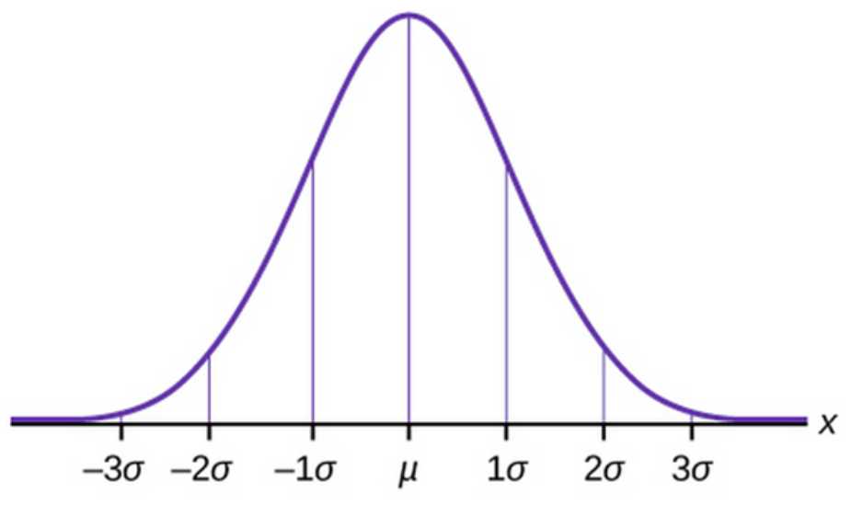
Coffee Example
It’s reported that 63% of American adults drink coffee every day. Let’s take a random sample of 300 U.S. adults.
Is this a large enough sample size to use the central limit theorem? Why?
What are the mean and standard deviation of the sampling distribution of sample proportions?
Find the probability that more than 67% of the sampled adults drink coffee daily.
What is the probability that fewer than 55% of the sampled adults drink coffee daily?
What proportion of sample proportions are between 60% and 70%?
What sample proportion is at the 10th percentile?
What sample proportion marks the highest 20%?

